Slide 1
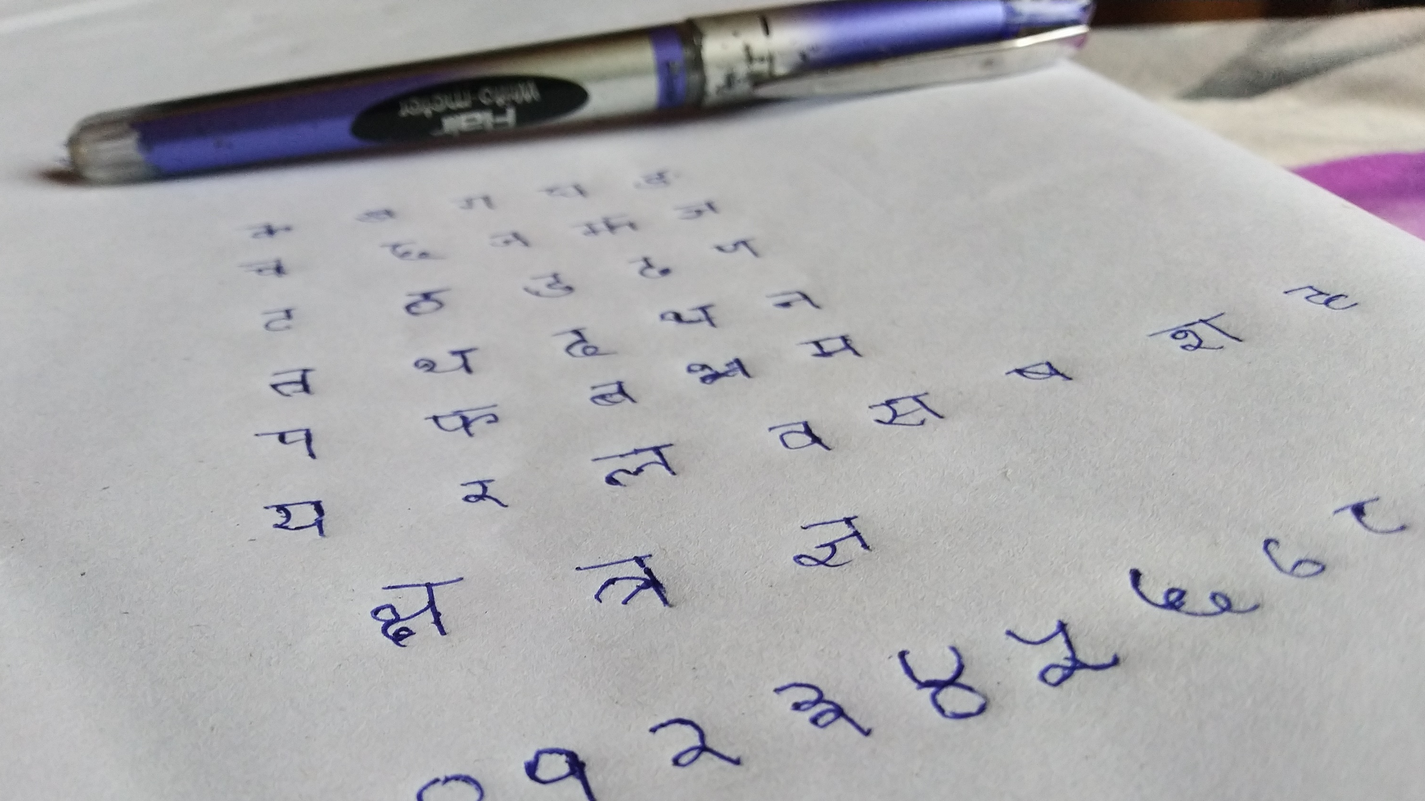
Devanagari Handwritten Character Recognition
KAUSTAV MAITY

Slide 2
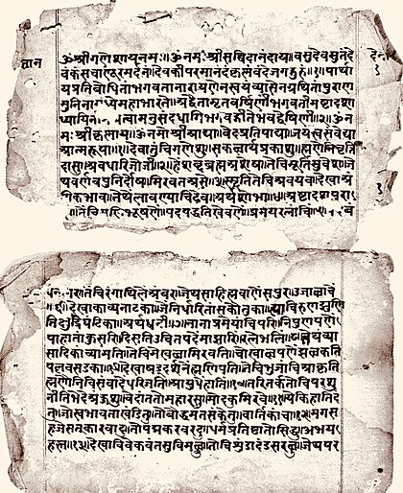
About Devanagari
Origin: Indian Subcontinent (Current India, Pakistan, Nepal etc.)
Time : 1st century -4th century
Letters: 14 vowels and 33 consonants
Novel Scripture : Bhagavat Gita

Slide 3
Dataset & Objective
Includes 46 characters ( 36 consonant and 10 numerals)
Vowels are not included
Each character has 1700 examples in the dataset
Each image is a grayscale image with 3 channels
Each image has size 32*32*3
Our objective is to train a Machine Learning/Deep Learning model that recognize Devanagari Characters

Slide 4
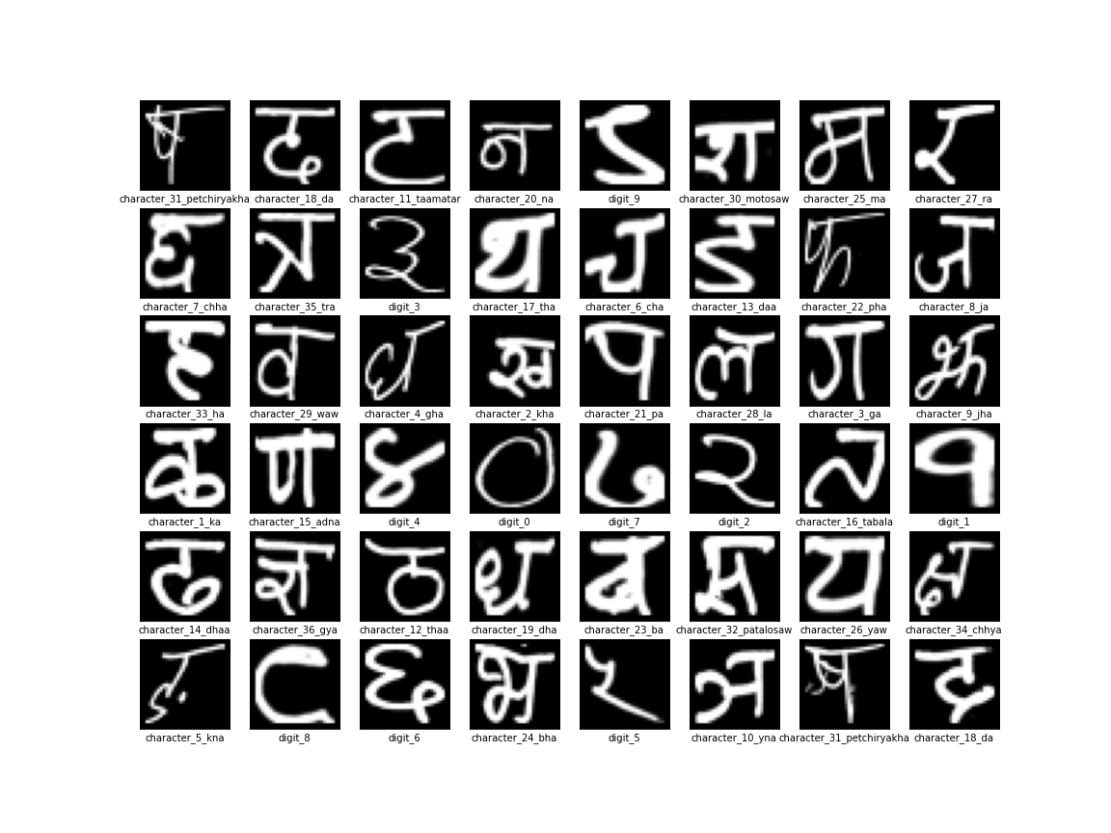
Examples

Slide 5
Build some Machine Learning model
Random Forest Classifier
This model did not performed very well. Here we have achieved 90% test accuracy.
Logistic Regression
This model performed poorly on test dataset. Here we have achieved 72% test accuracy

Slide 6
Build our ANN model
Model has 3 hidden layer with dropout and batch normalization
The model has been trained for 20 epochs
We used sparse categorical cross entropy as the loss function
We got train accuracy 0.9476, validation accuracy 0.9393 , test accuracy 0.9445
Performed quite well

Slide 7
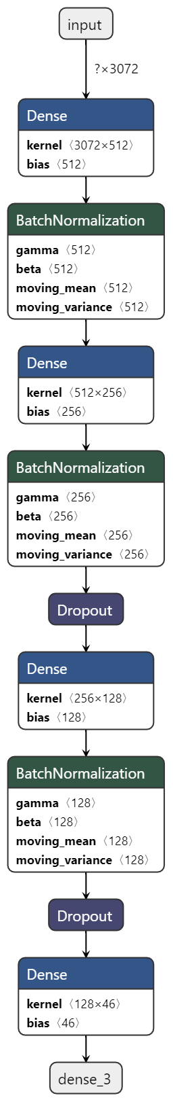
Model Architecture

Slide 8
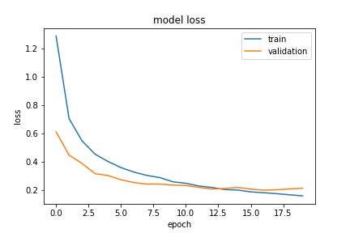
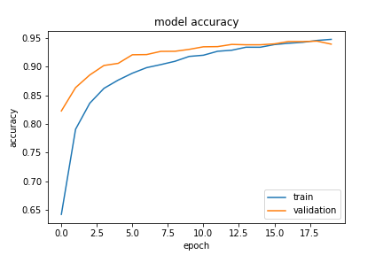
Learning Curves
Figure 1 : Epoch v/s Loss curve
Figure 2: Epoch v/s Accuracy curve
We get optimum accuracy at epoch 15

Slide 9
Building CNN model
Model has 3 Convolution layer followed by MaxPool and Dropout , then 3 Dense Layer with dropout
Model is trained for 20 epochs
We have used sparse categorical cross entropy as the loss function
We got train accuracy 0.9869 , validation accuracy 0.9902 and test accuracy 0.99 after 20 epochs
Performed better than ANN because it can detect features from a picture

Slide 10
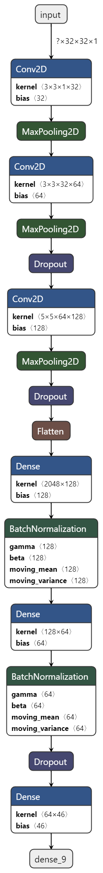
Model Architecture

Slide 11
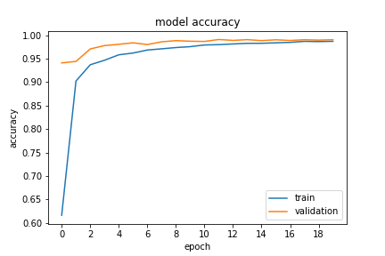
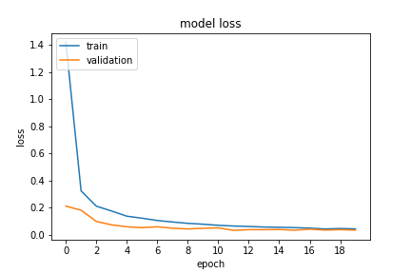
Learning Curves
Figure 1 : Epochs v/s Accuracy
Figure 2 : Epochs v/s Loss
Model is perfectly fitted

Slide 12
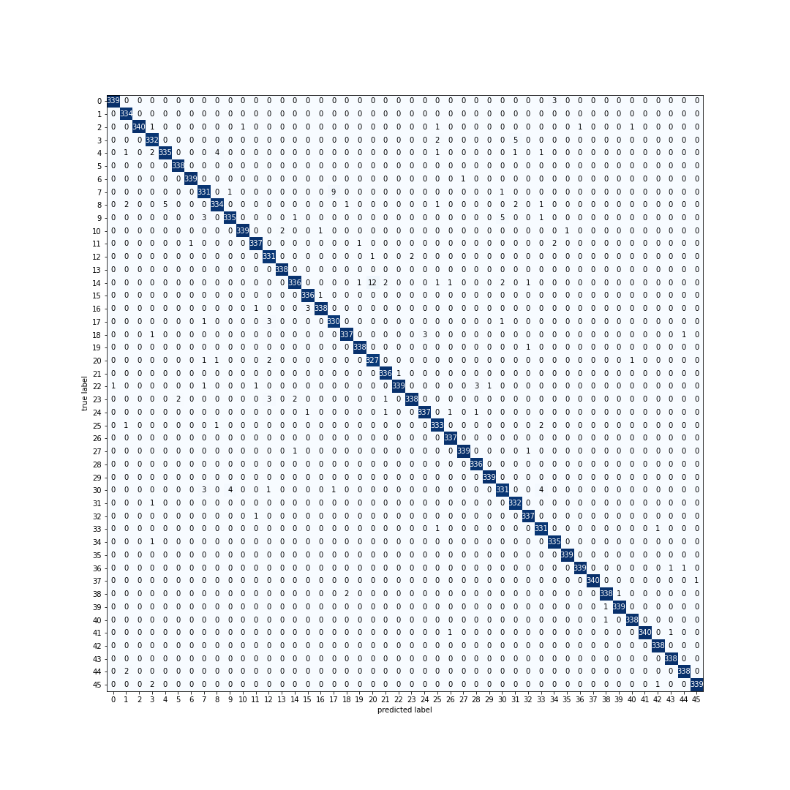
Confusion Matrix

Slide 13
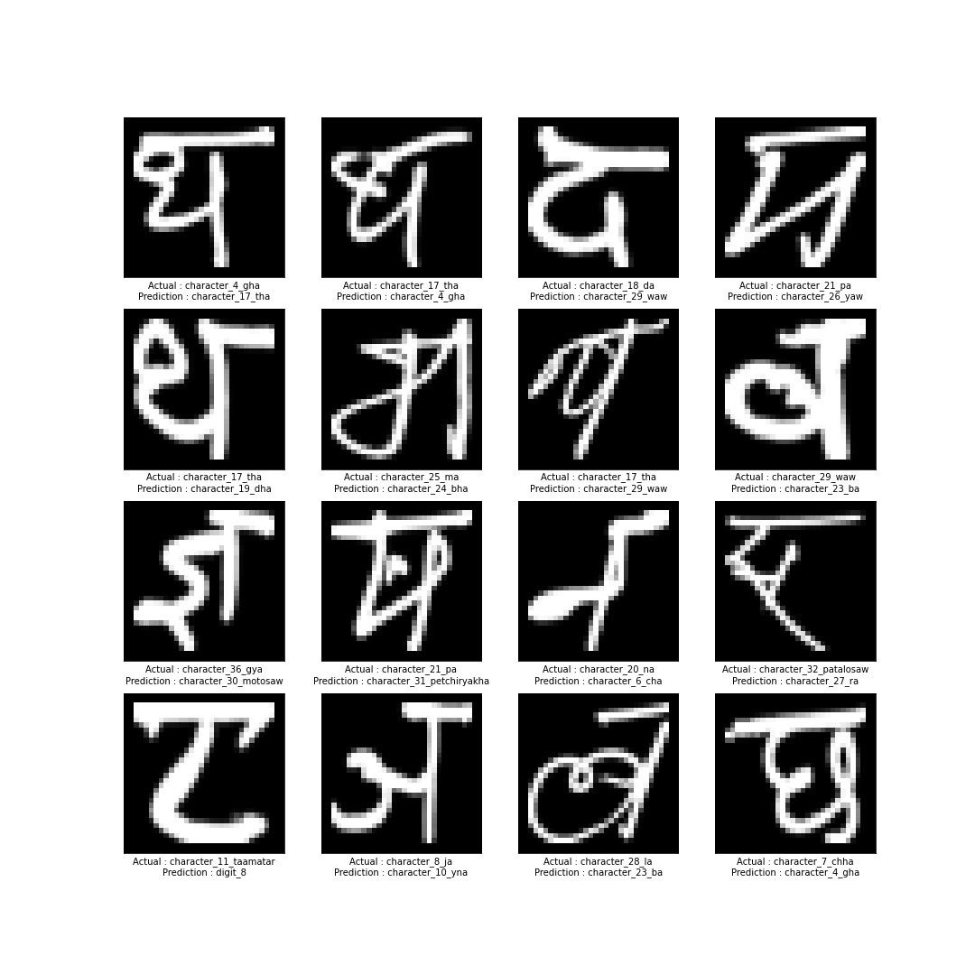
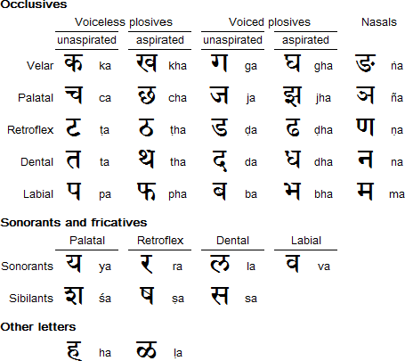
Let us have a closer look in the misclassified examples

Slide 14
How these issues can be resolved?
Difficult to understand for a human also
Letters are looking alike
Distinguish the characters base on the context (For example “म” and “भ” are similar looking words . In the word “अहम” the context is the word itself . Model will assoiciate more probability on “म” after “अह” than “भ”
We can use RNN for this

Slide 15
Testing With Complete Different Dataset
Consists almost 12000 examples after dropping vowels
Images have shape (28,28,3)
Unfortunately these set of images have a different notations for characters

Slide 16
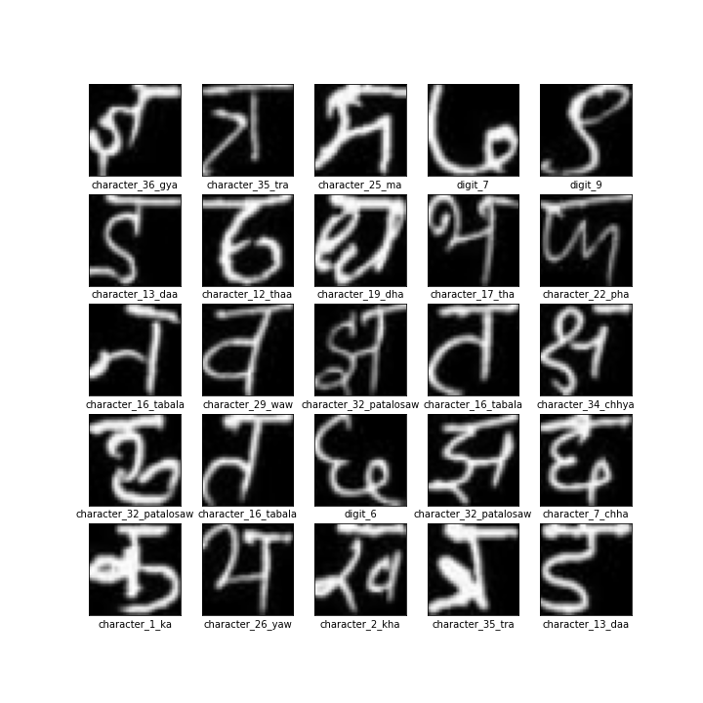
Let’s try to figure out predictions are correct or not

Slide 17
Applications
Scripture reading
Language Translation
Text to audio translation
*All these applications needs more characters to train

Slide 18
Thank you

